Slide 1
FoodHub
Python Foundations
03/25/2025

Slide 2
Contents / Agenda
Executive Summary
Business Problem Overview and Solution Approach
Data Overview
EDA - Univariate Analysis
EDA - Multivariate Analysis
Appendix

Slide 3
Executive Summary
Conclusions:
American and Japanese cuisines have the bigger order volume, with American food being the top 1 cusine. Hence, you see the local market preferences.
Customers care about delivery seeing a direct corrolation with delivery time and rating. The longer it takes, the rating gets worse.
Weekend deliveries run about 3-4 minutes slower than weekday ones.
Expensive orders don't necessarily get better ratings. Looks like people just want good food delivered quickly, regardless of how much they spent.
Recommendations:
Change delivery fees based on distance and time of day. This will be similar to what UBER does for their rides. However, we are doing this with food delivery.
Incentivize given a rating. more than 700 records did not have a rating which could help stabilize some of the lower performance rating. As you could see customers with the highest orders gave over 4 rating except 1.
Create a simple points system for our regulars.
I checked the data and just keeping our top 5% of customers happy would make a huge difference to the bottom line.
Note: You can use more than one slide if needed

Slide 4
Business Problem Overview and Solution Approach
Business Problem
FoodHub needs data-driven insights to optimize their food delivery operations in New York's competitive market, enhance customer satisfaction, and increase revenue.
Recommendations
Implement tiered delivery fees based on distance and time of day
Create loyalty program for frequent customers
Establish stricter service agreements with slow-preparing restaurants
Feature high-performing restaurants (4+ rating) prominently in the app
Add real-time order tracking to improve customer experience
Target expansion of American and Japanese cuisine options
Expected Impact
Implementation of these recommendations will lead to improved delivery times, higher customer satisfaction, increased order frequency, and ultimately greater market share in the competitive food delivery sector.

Slide 5
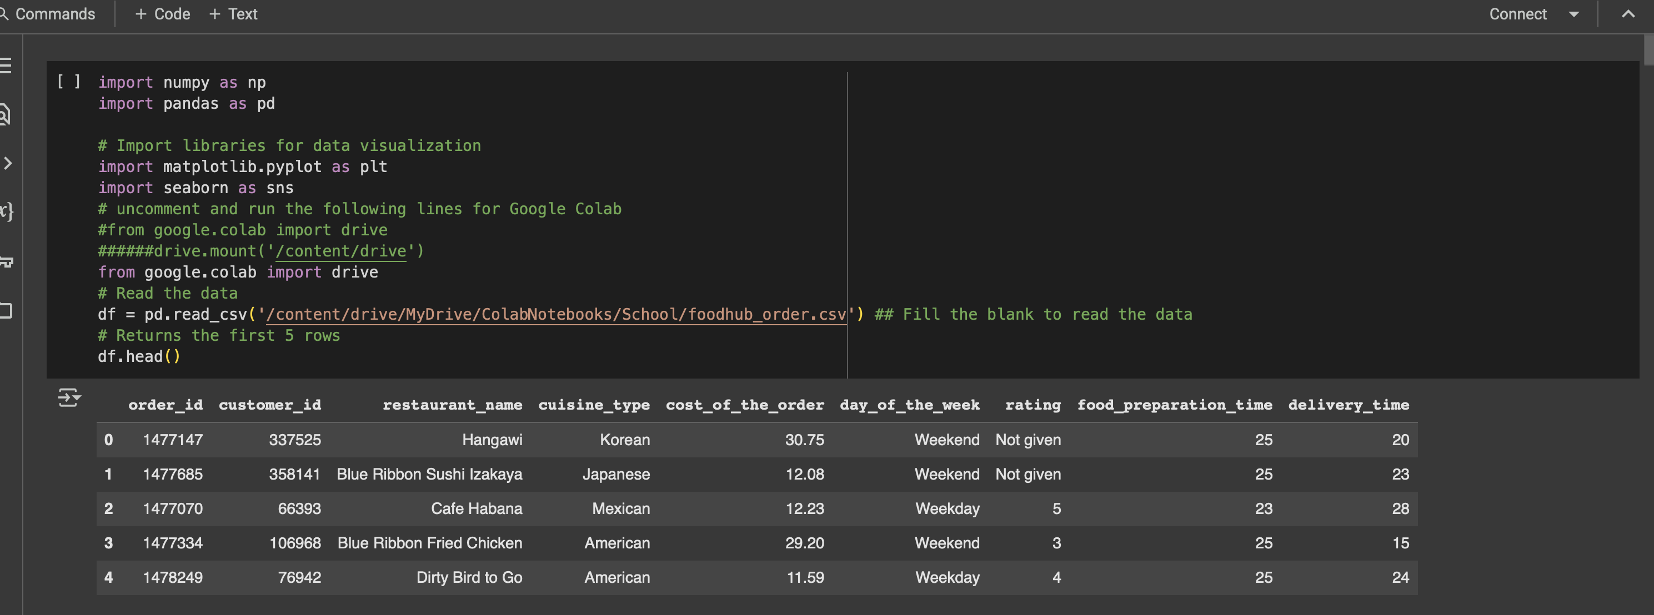
Data Overview

Slide 6
Data Overview

Slide 7
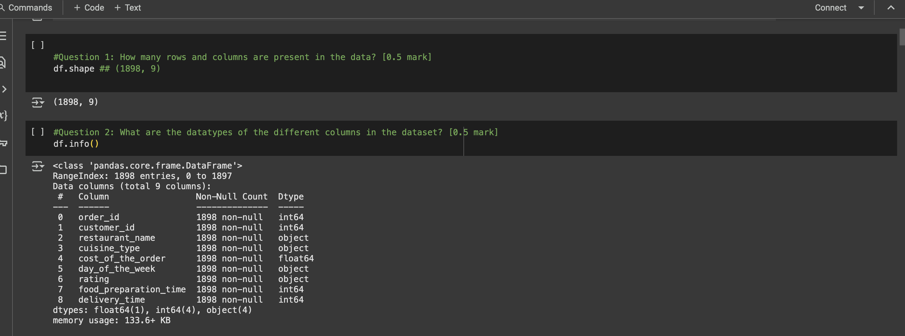
Data Overview

Slide 8
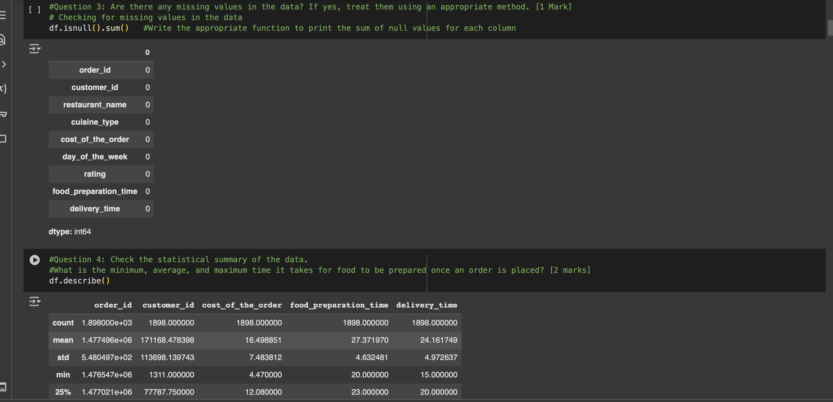
Data Overview

Slide 9
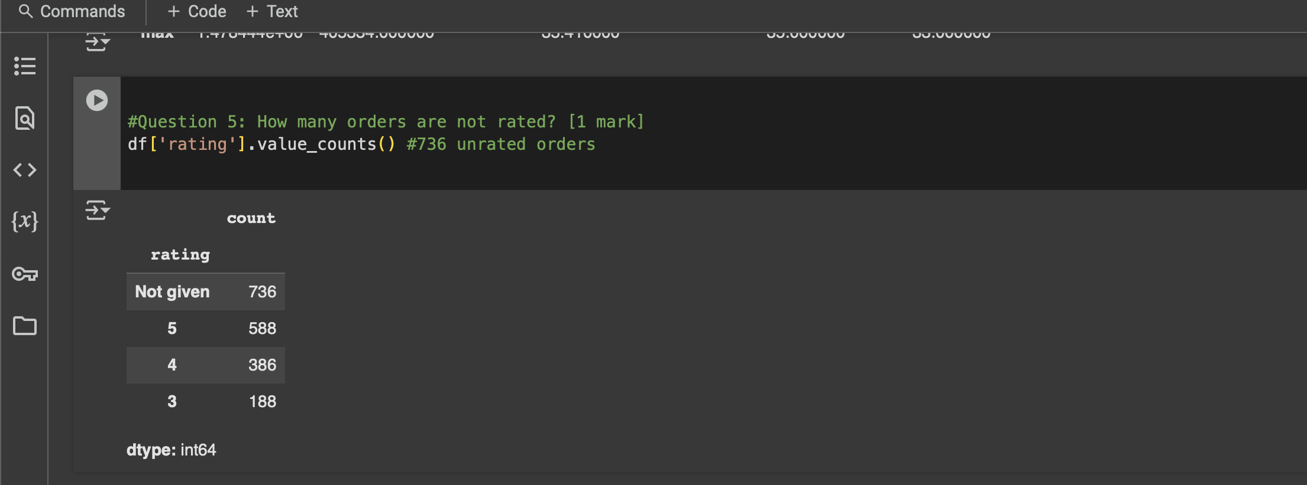
Data Overview

Slide 10
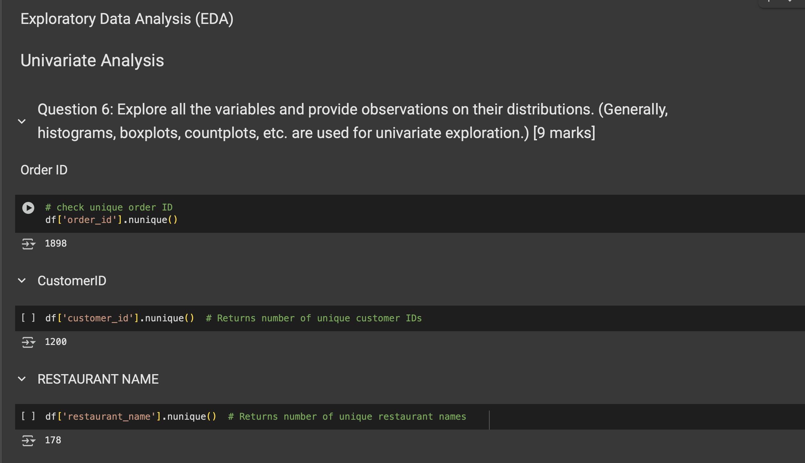
Univariate Analysis

Slide 11
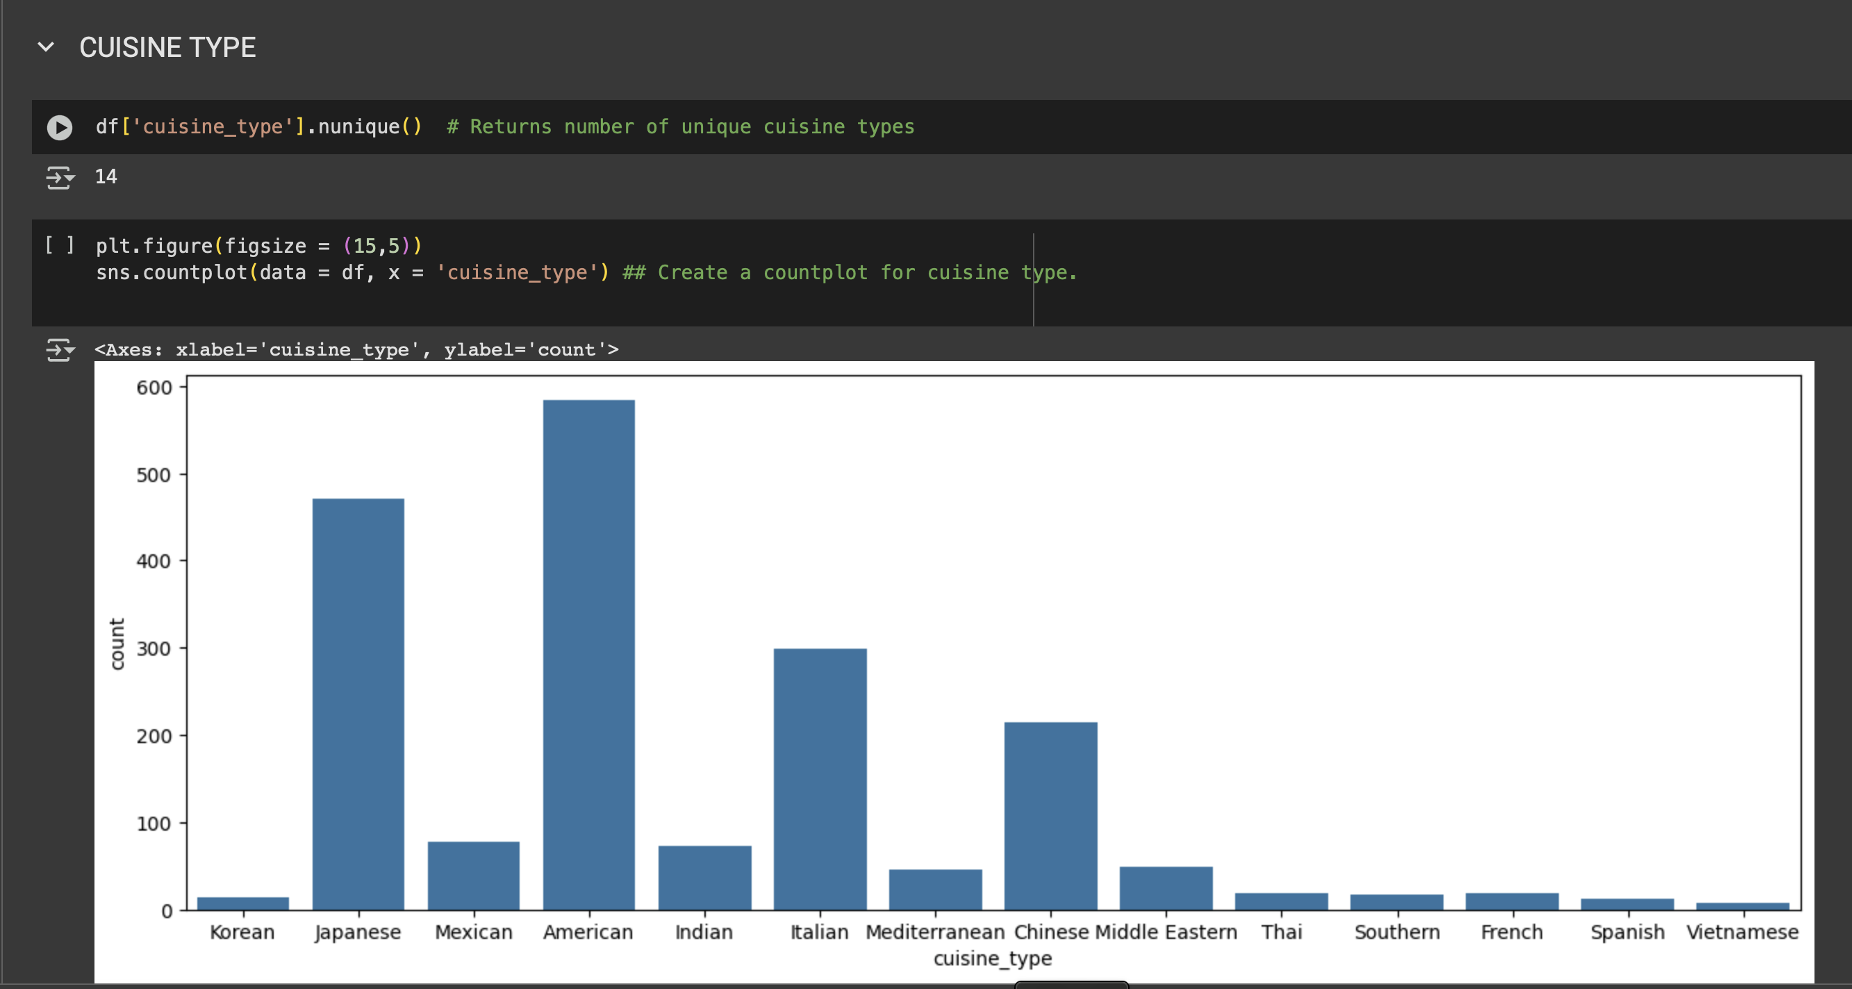
Univariate Analysis

Slide 12
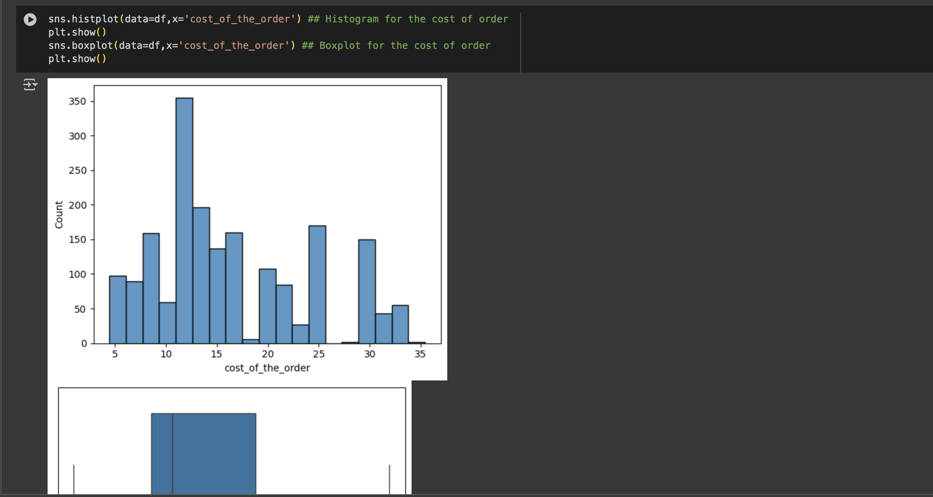
Univariate Analysis

Slide 13
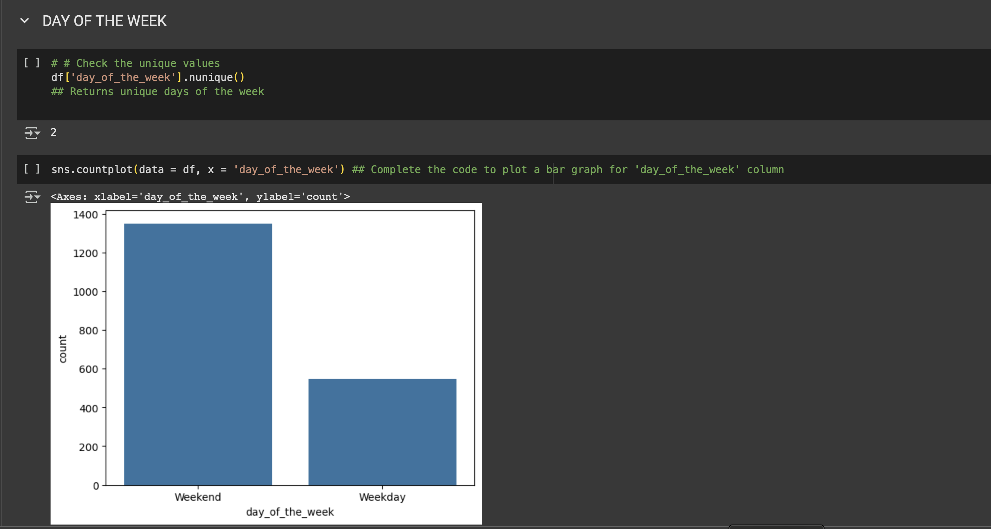
Univariate Analysis

Slide 14
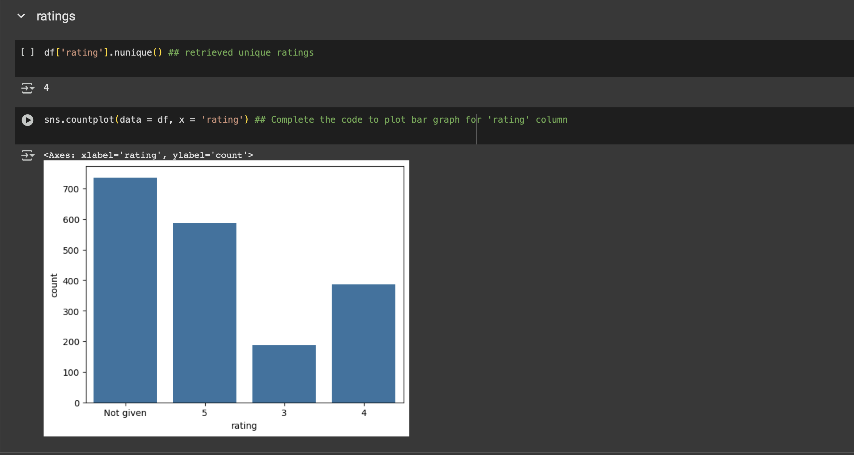
Univariate Analysis

Slide 15
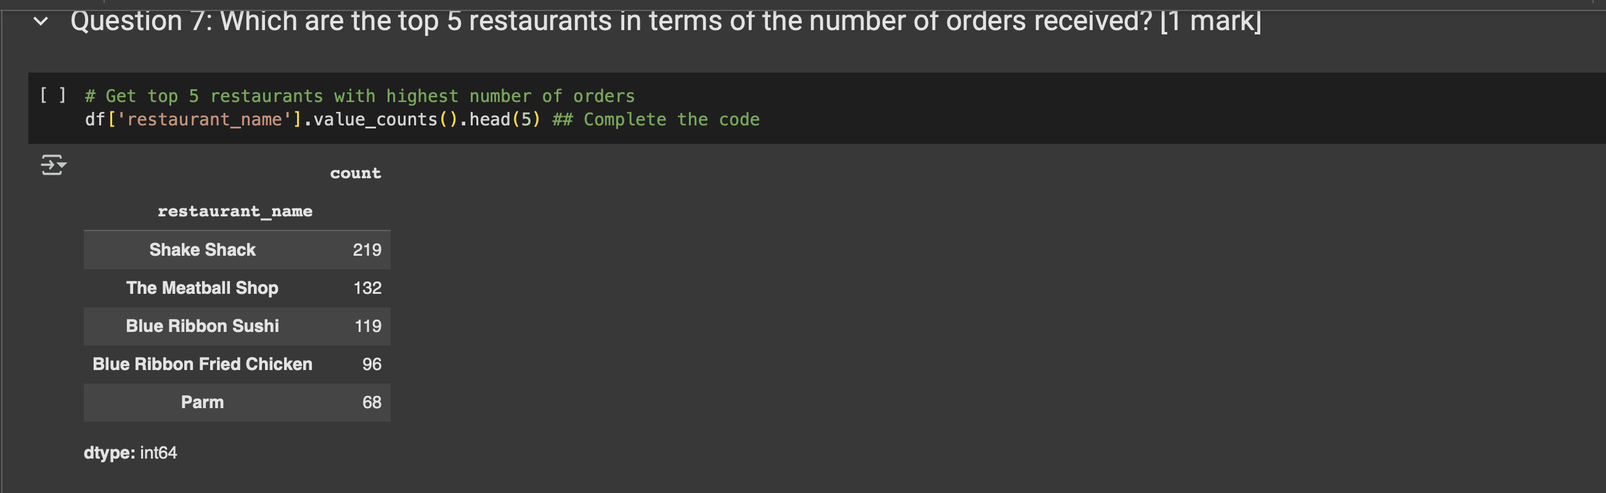
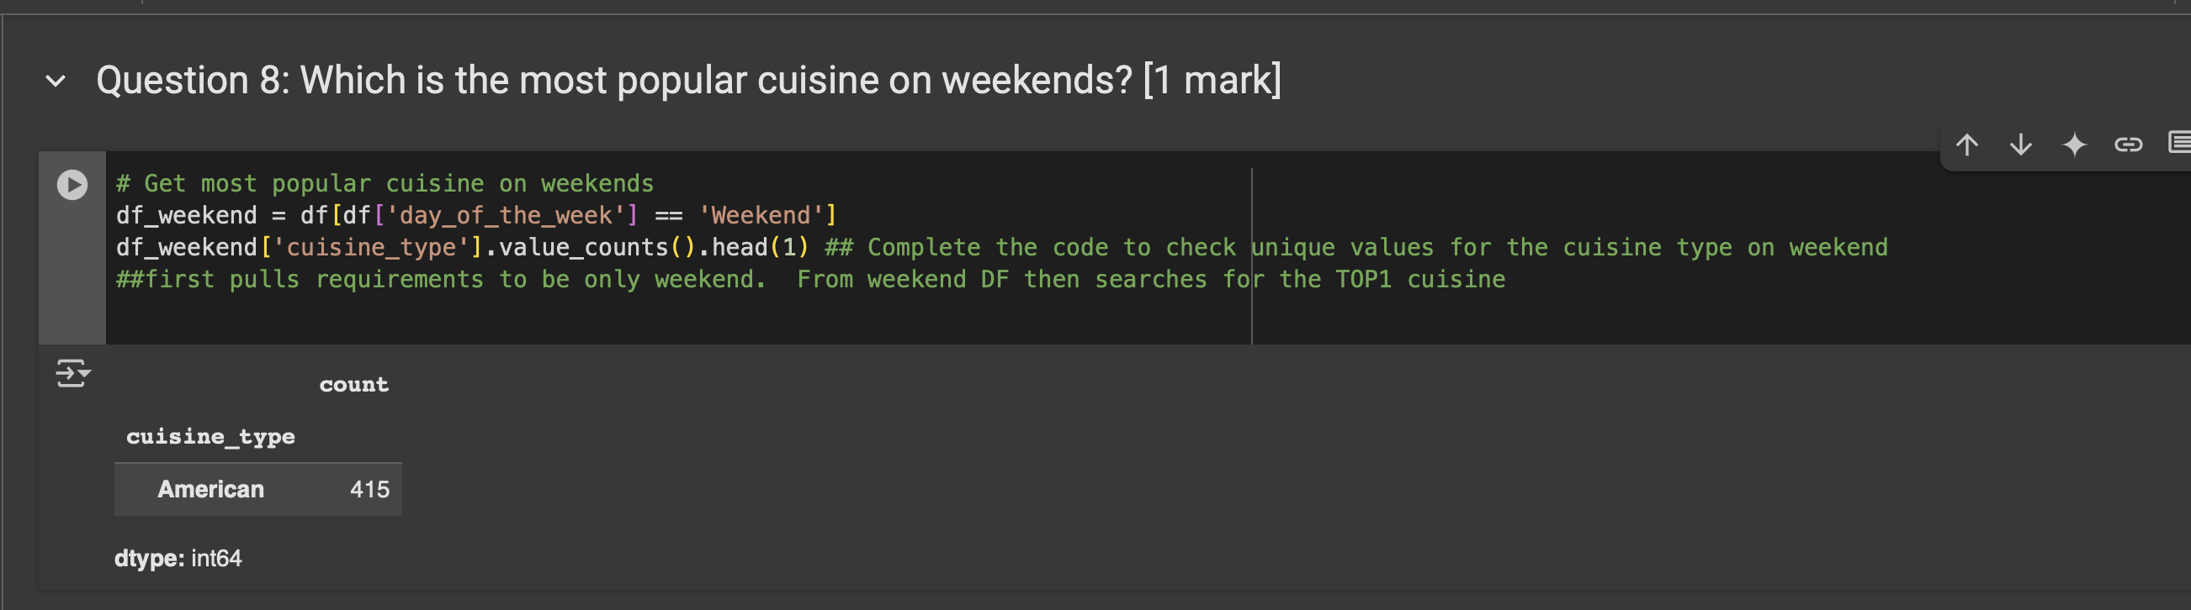
Univariate Analysis

Slide 16
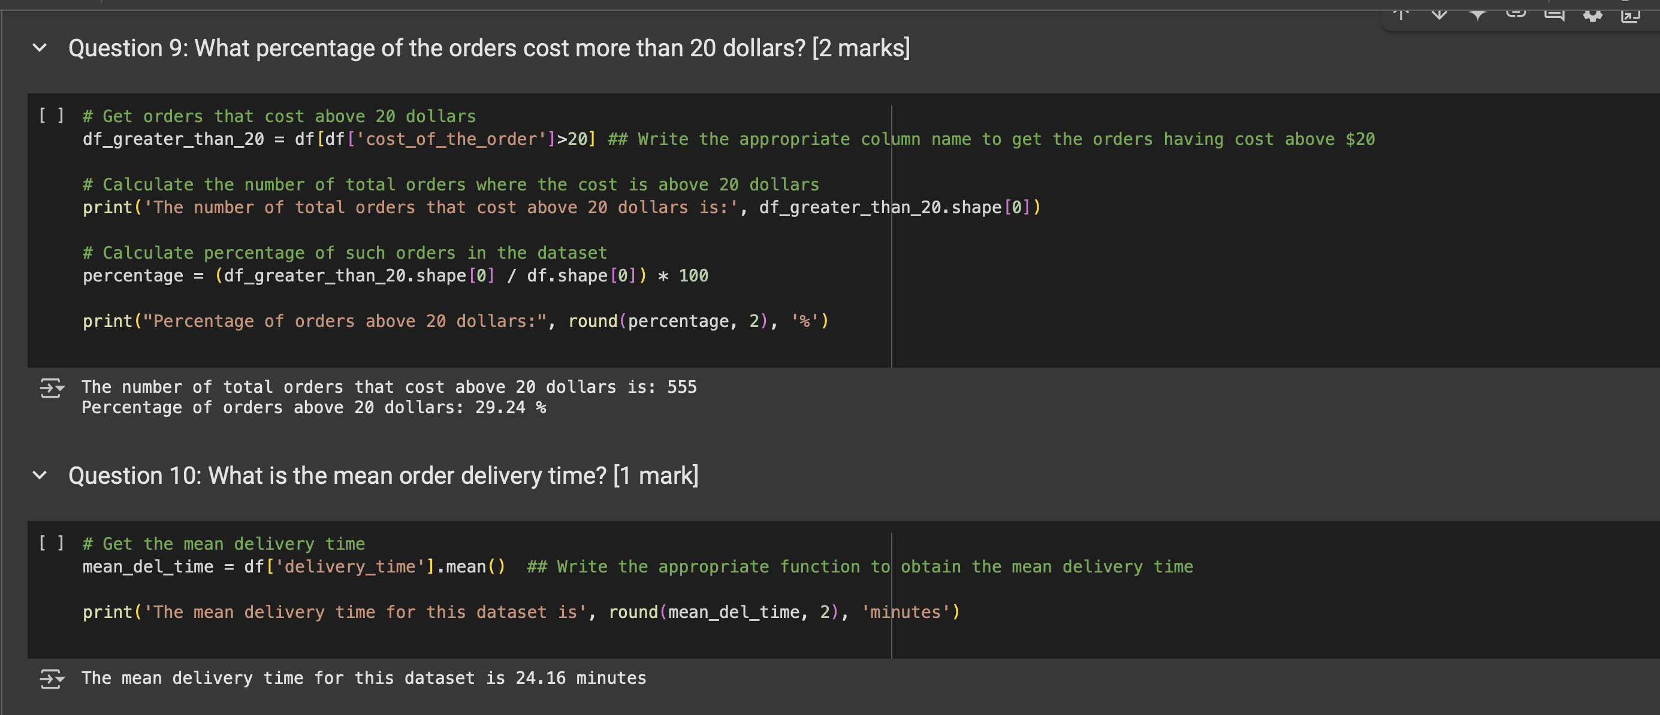
Univariate Analysis

Slide 17
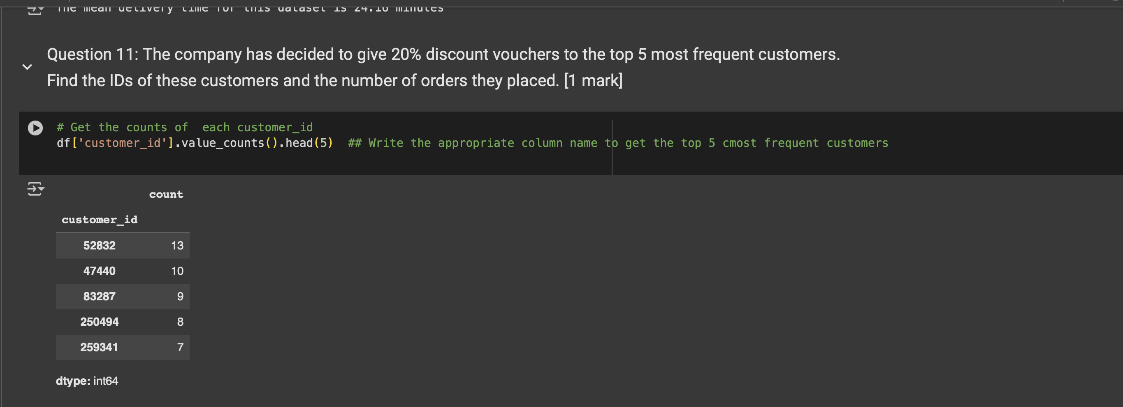
Univariate Analysis

Slide 18
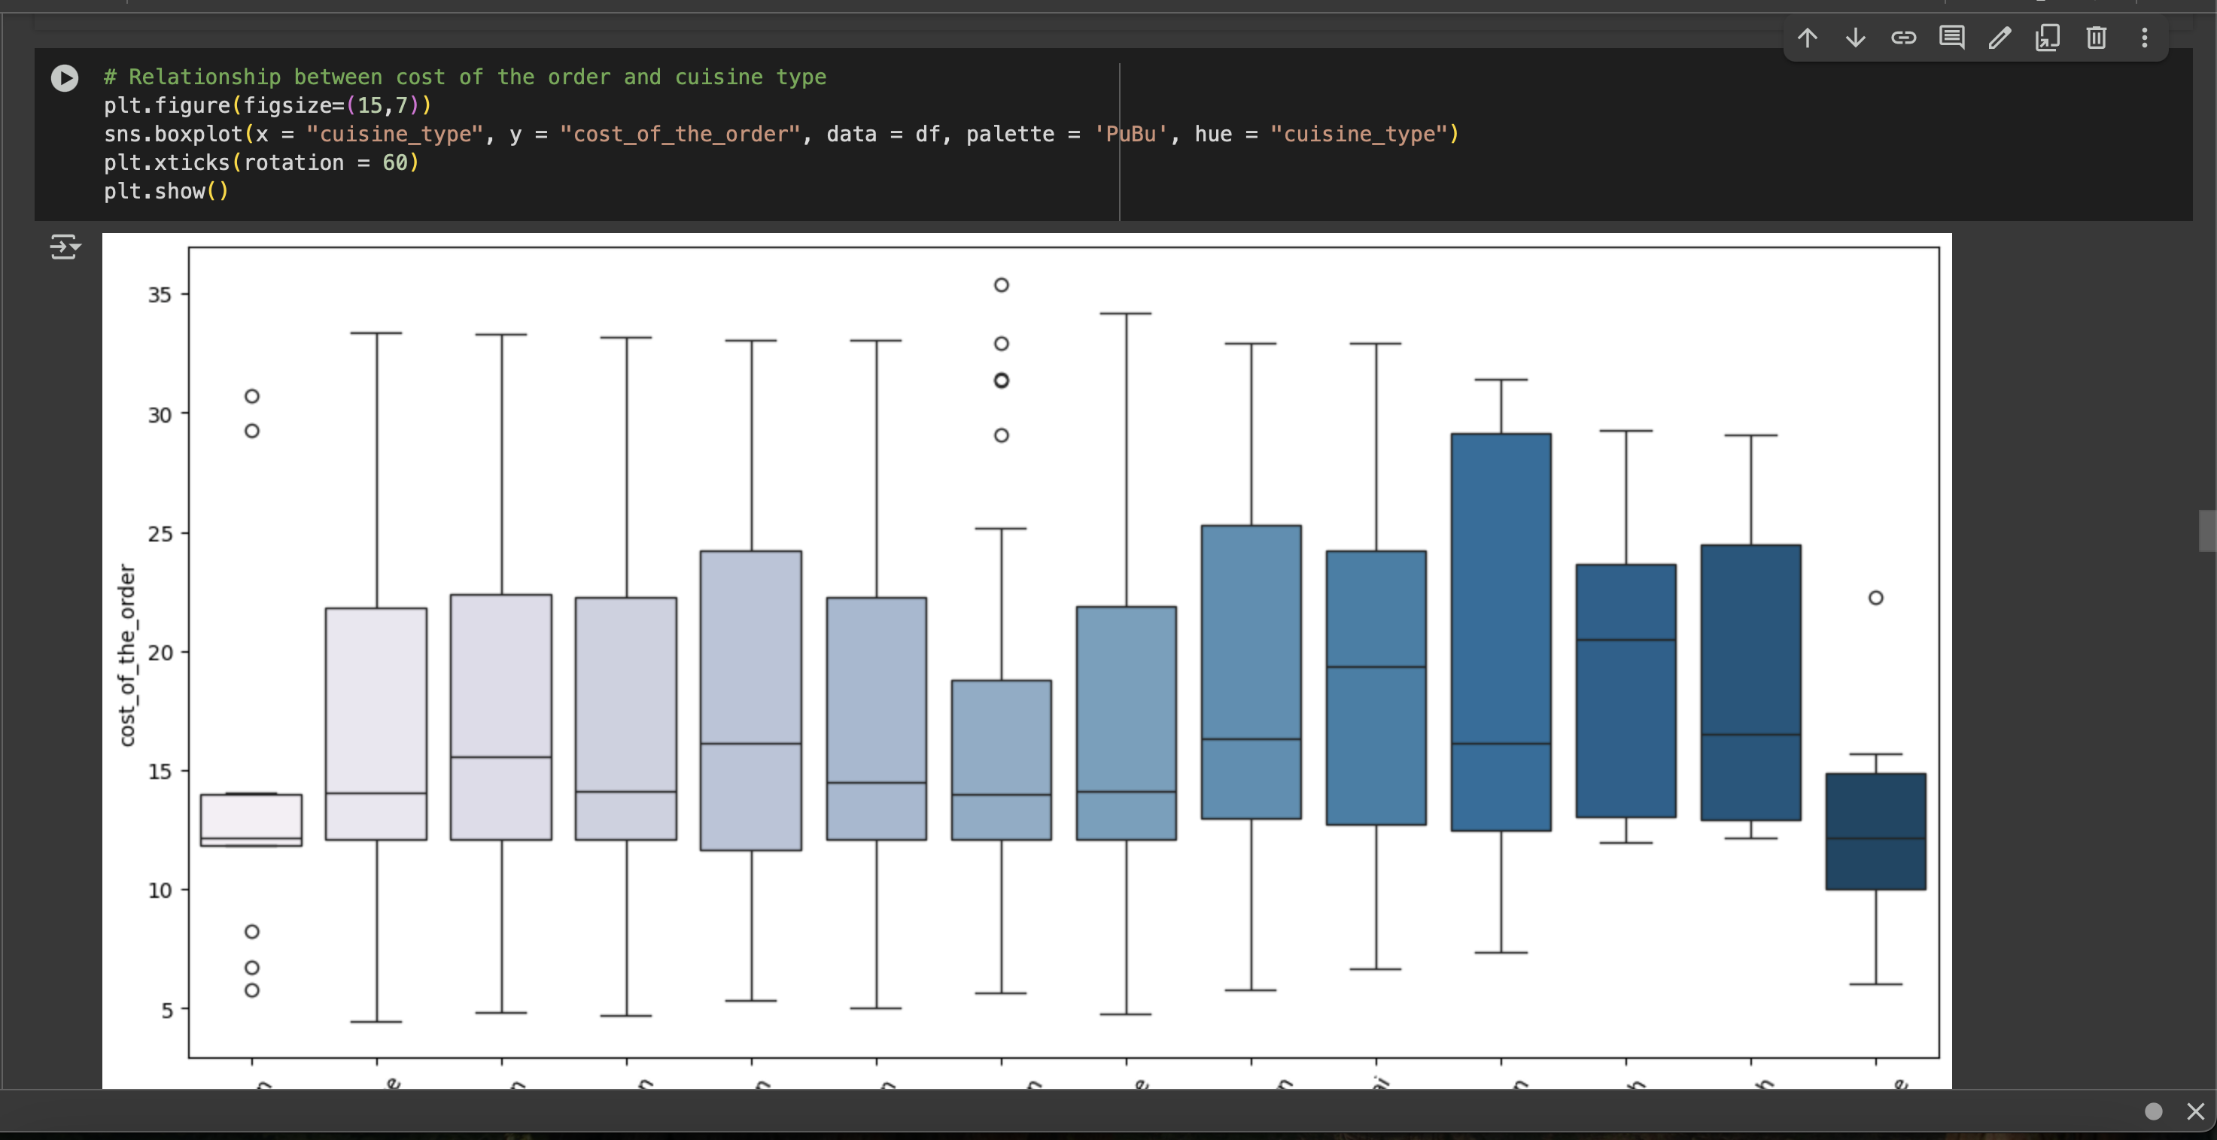
Multivariate Analysis

Slide 19
Multivariate Analysis

Slide 20
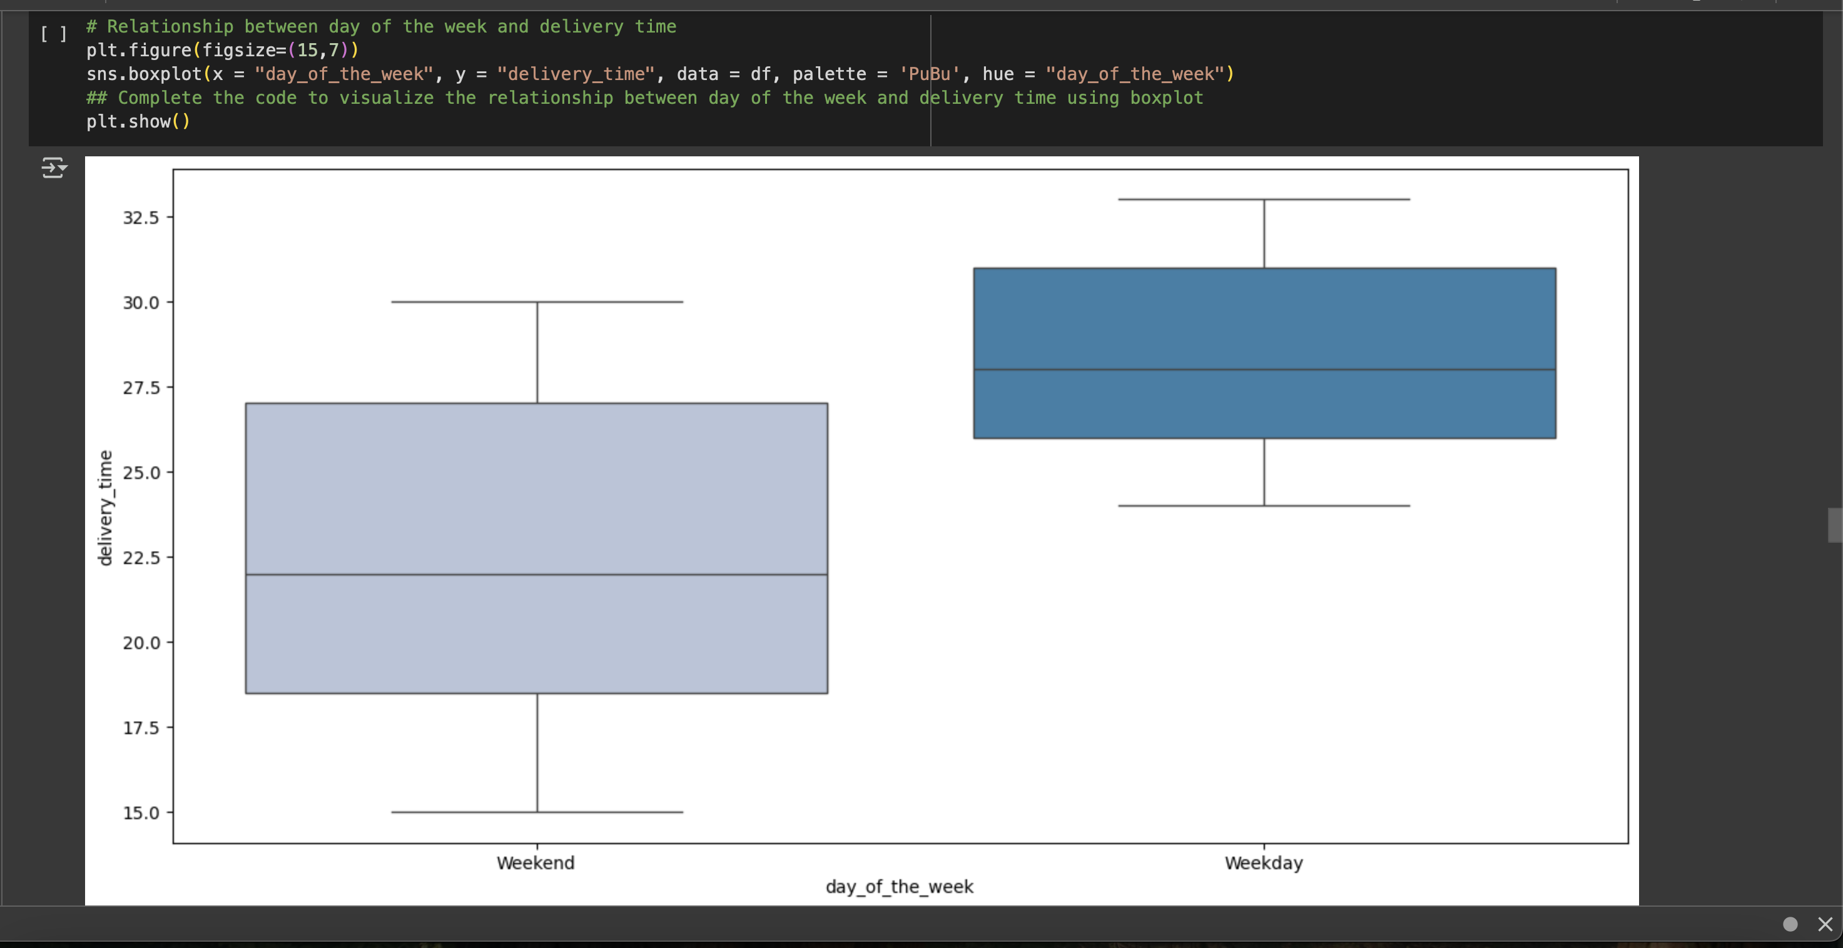
Multivariate Analysis

Slide 21
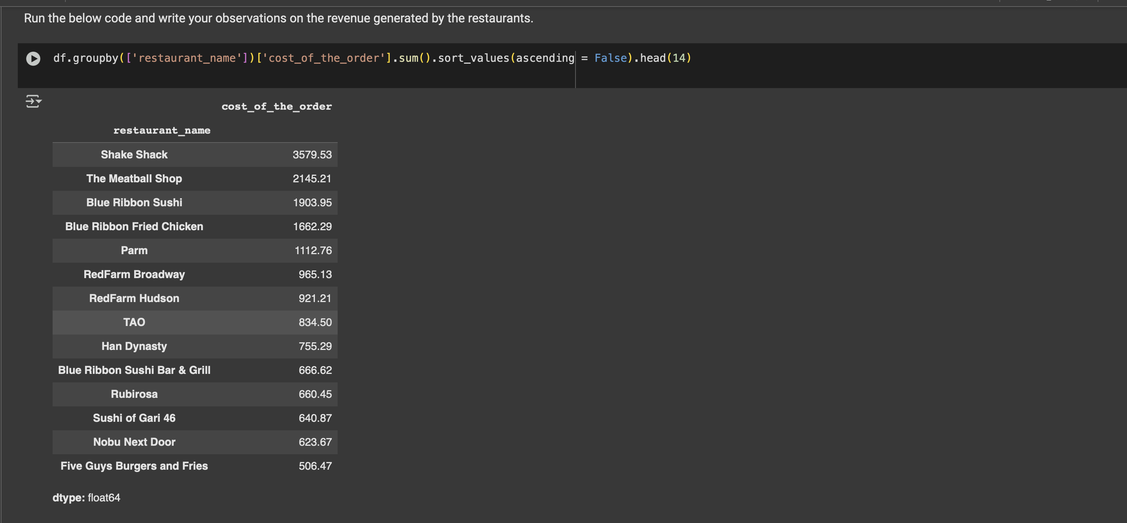
Multivariate Analysis

Slide 22
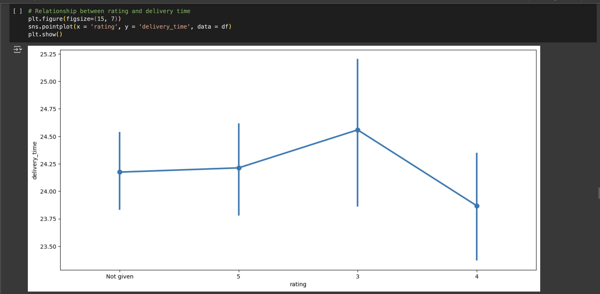
Multivariate Analysis

Slide 23
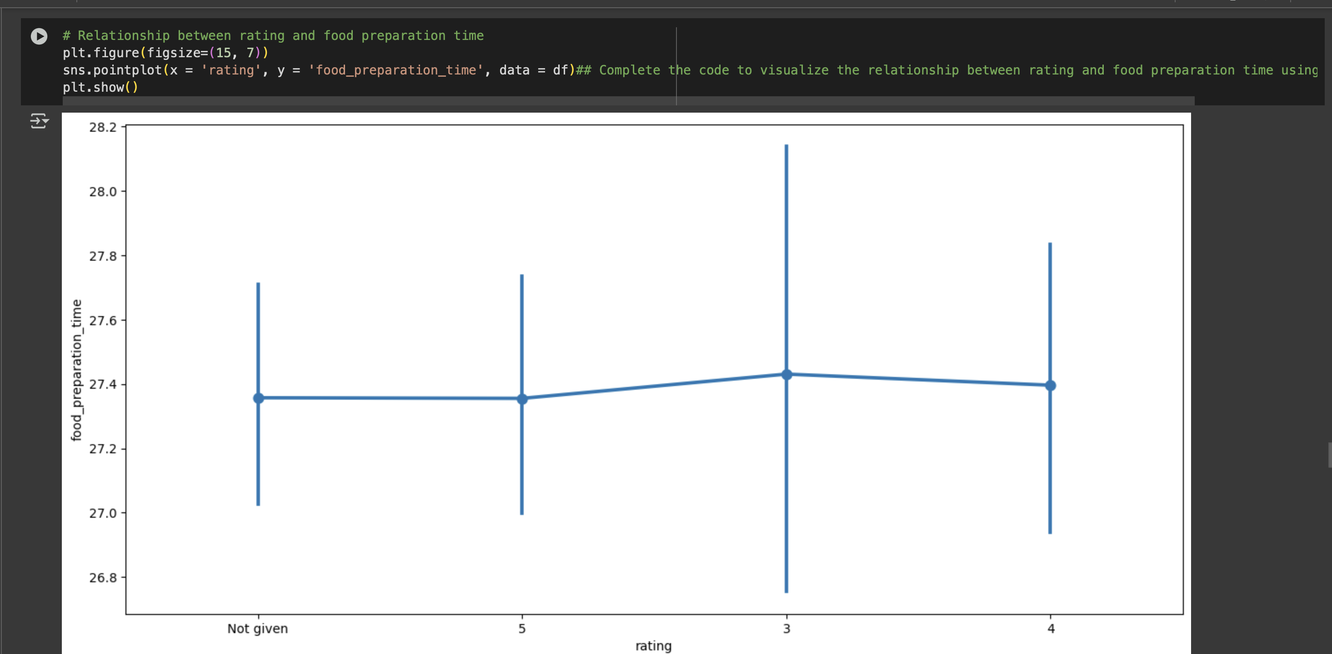
Multivariate Analysis

Slide 24
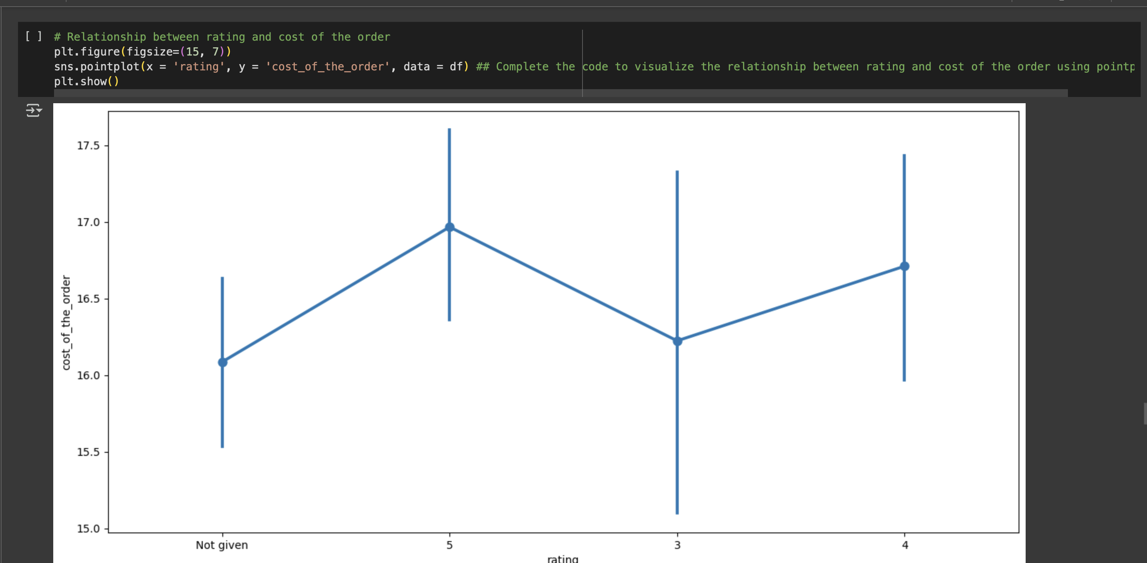
Multivariate Analysis

Slide 25
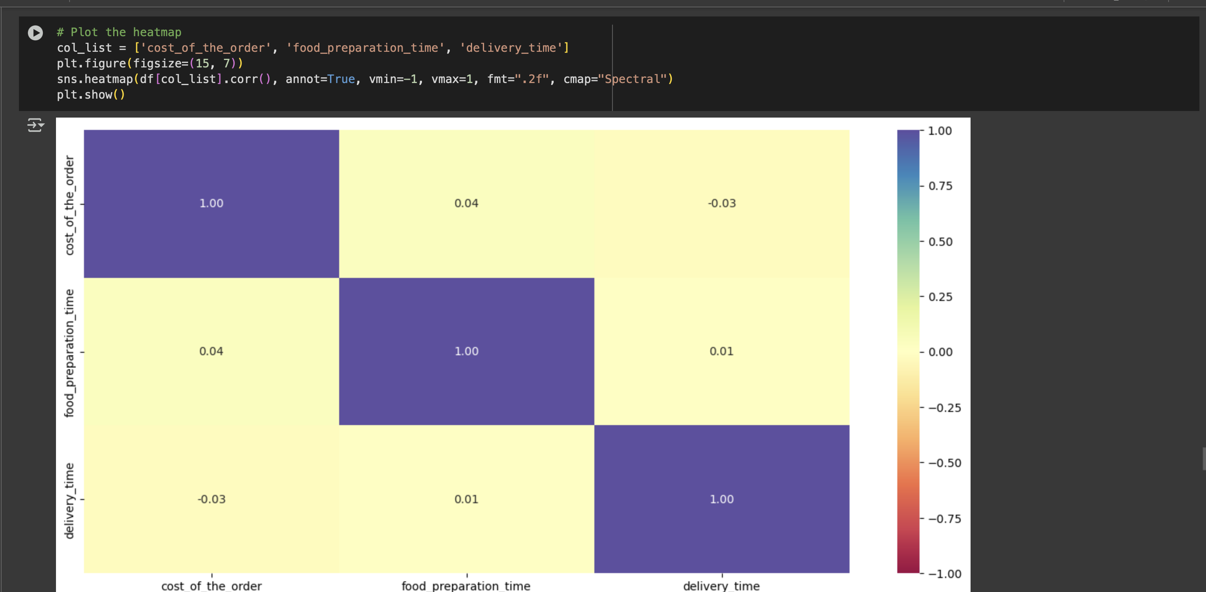
Multivariate Analysis

Slide 26
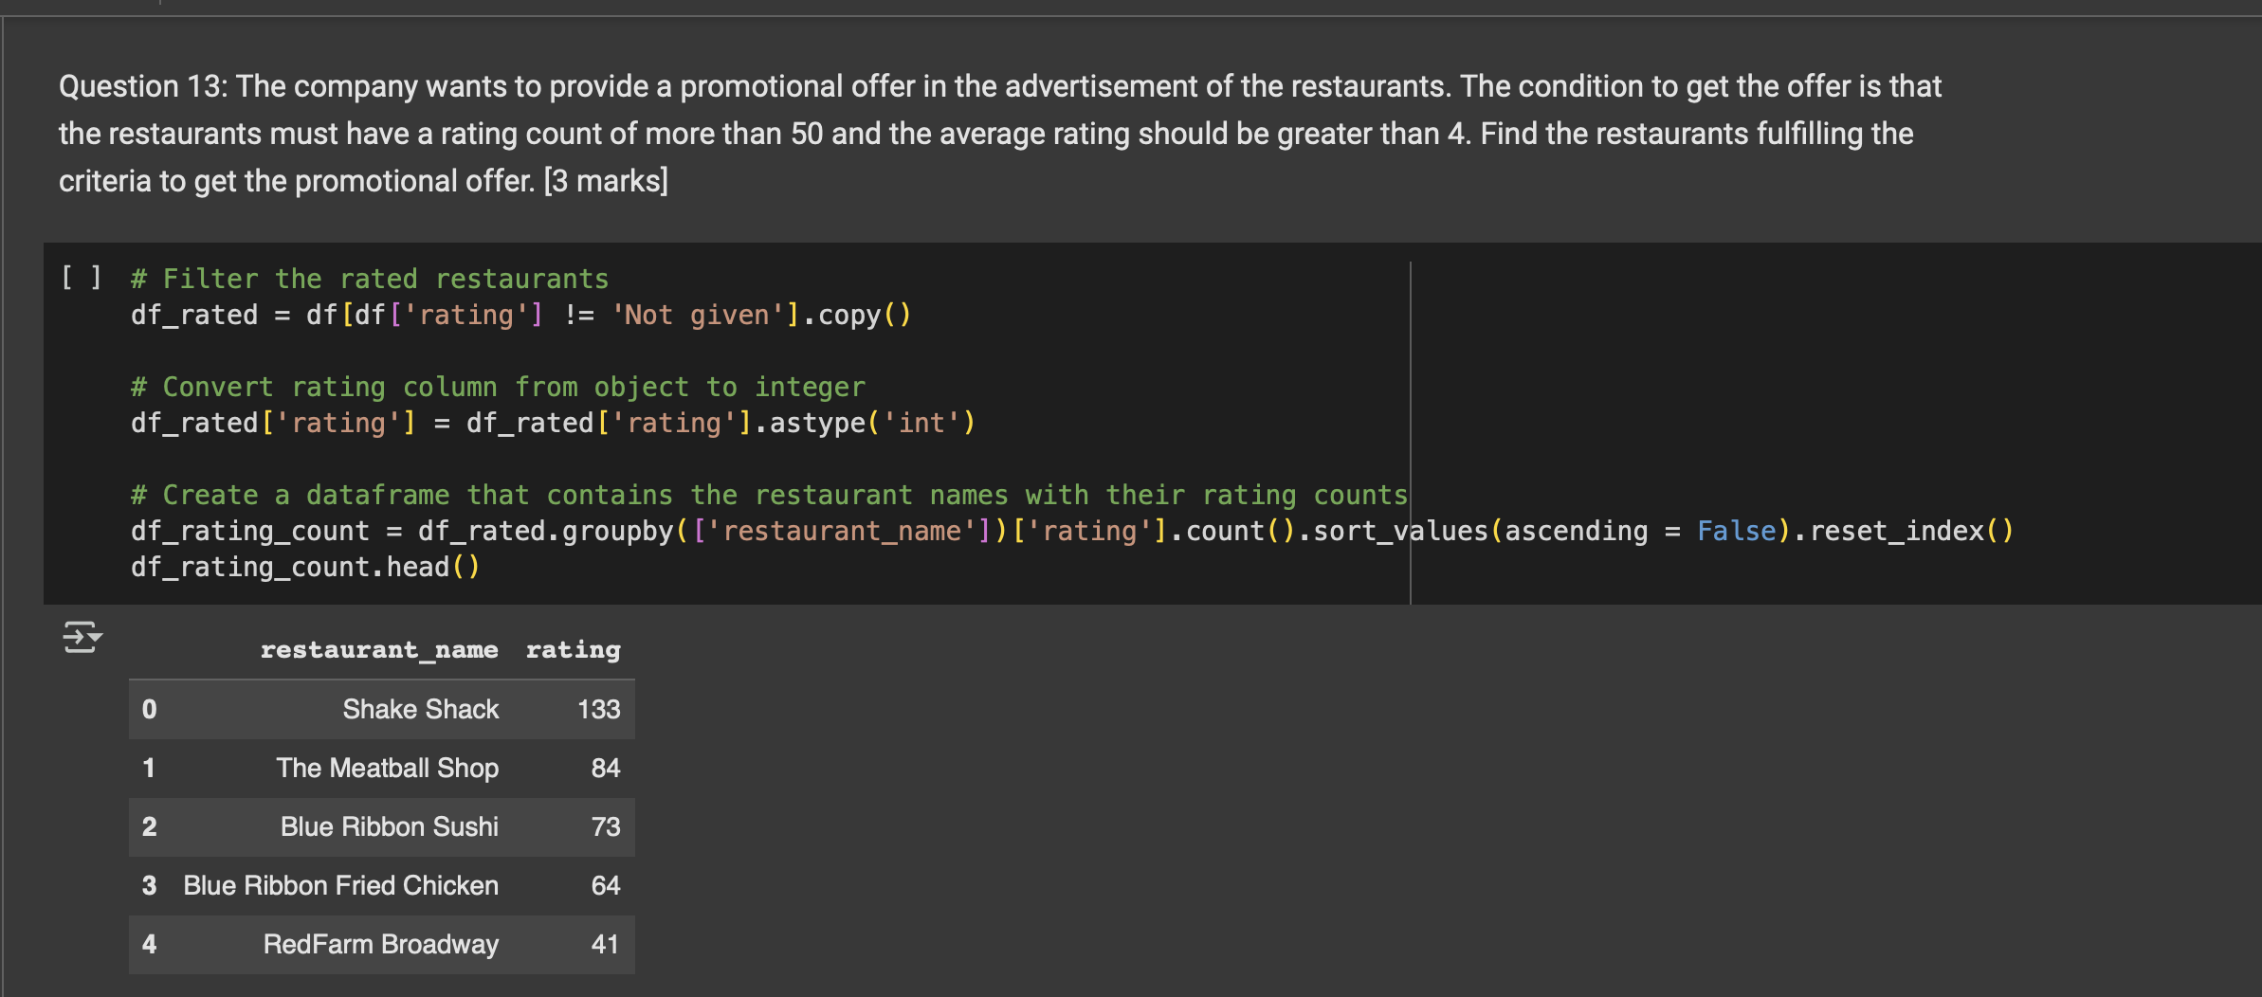
Multivariate Analysis

Slide 27
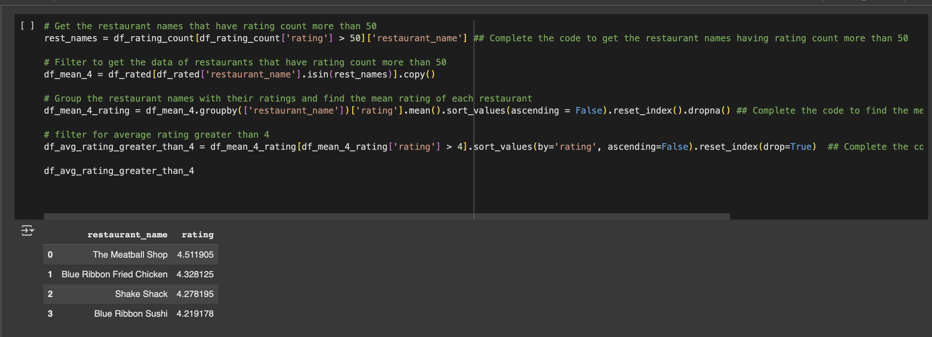
Multivariate Analysis

Slide 28
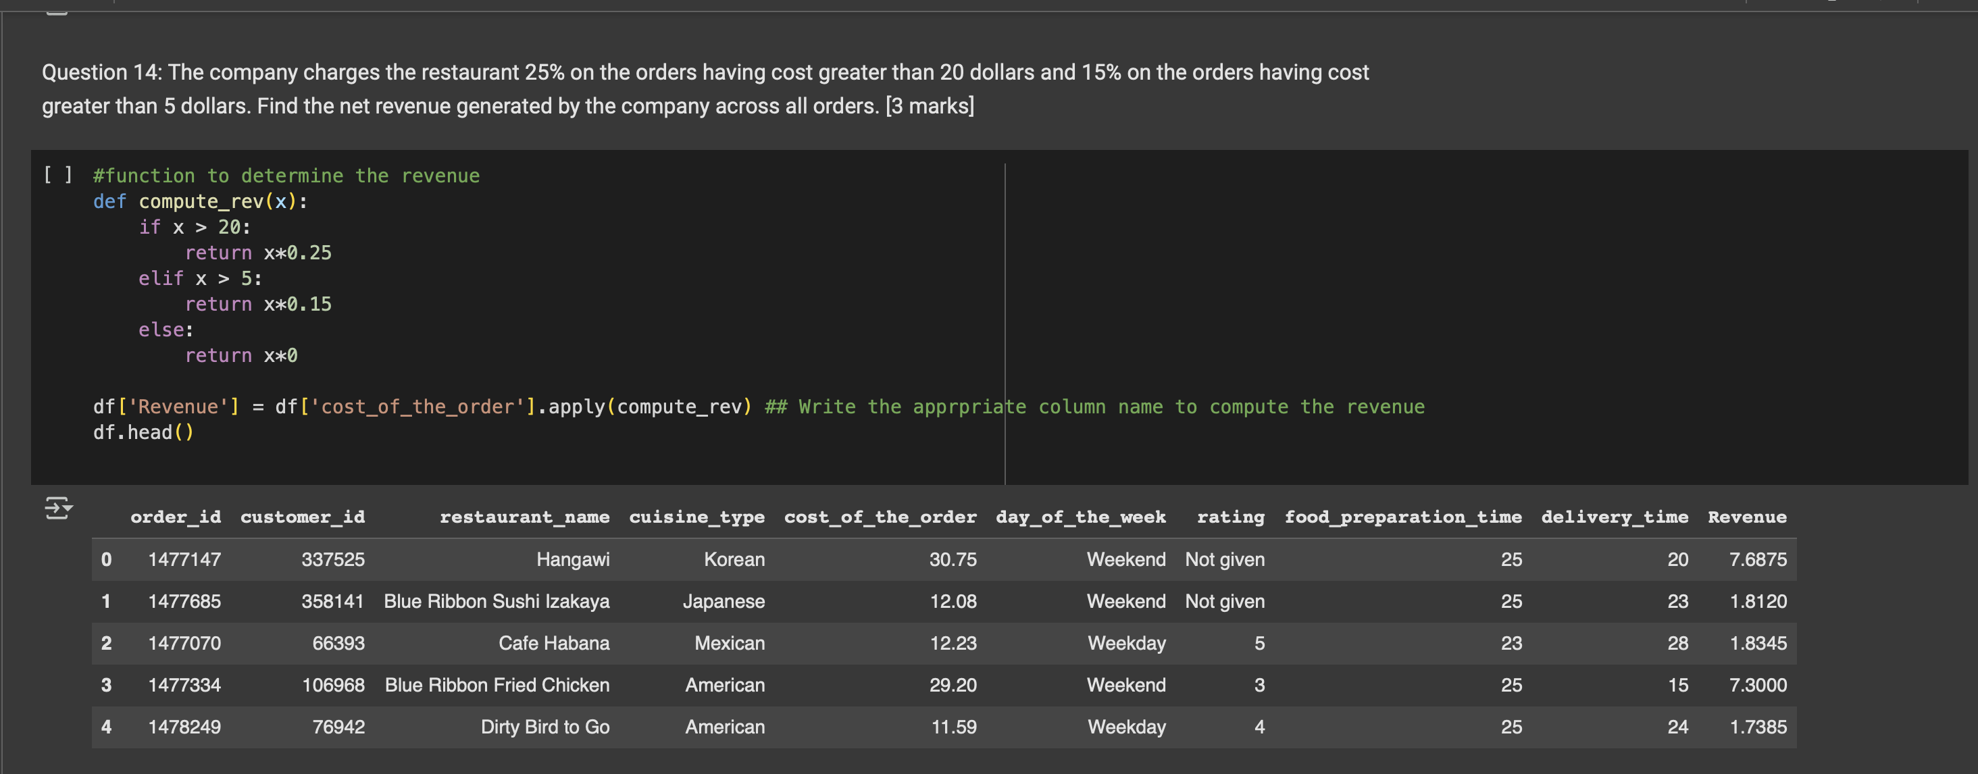
Multivariate Analysis

Slide 29
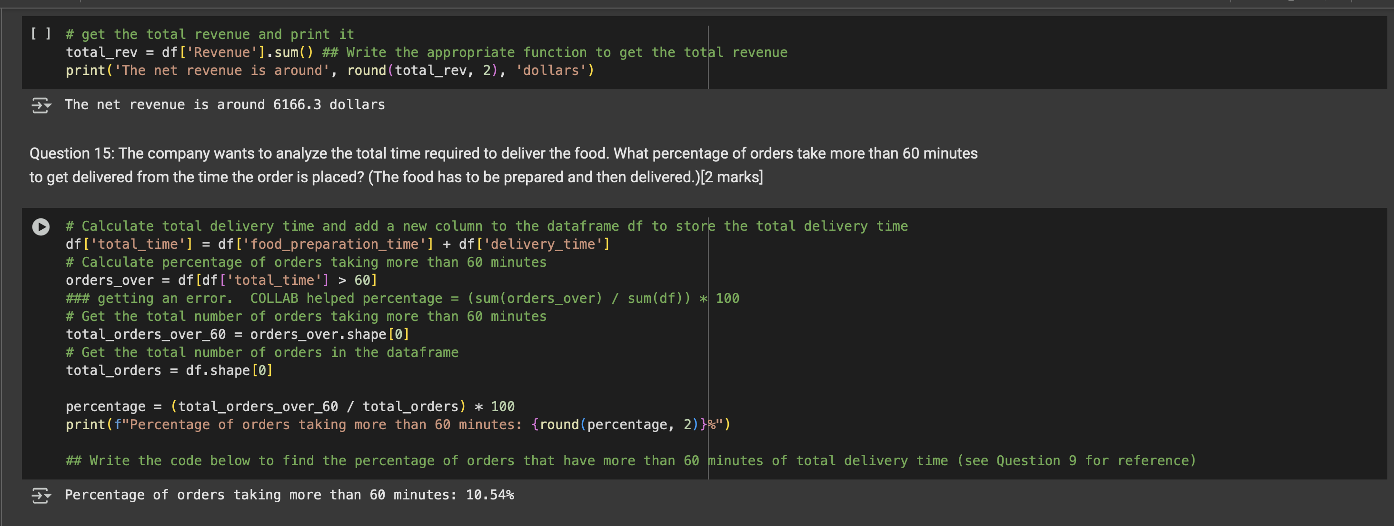
Multivariate Analysis

Slide 30
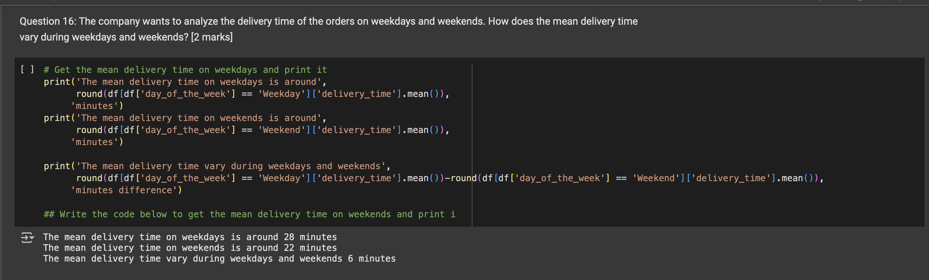
Multivariate Analysis

